Slide 1


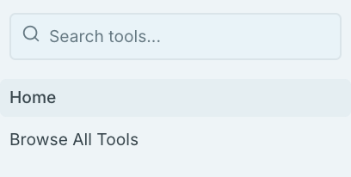
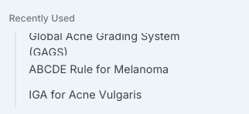
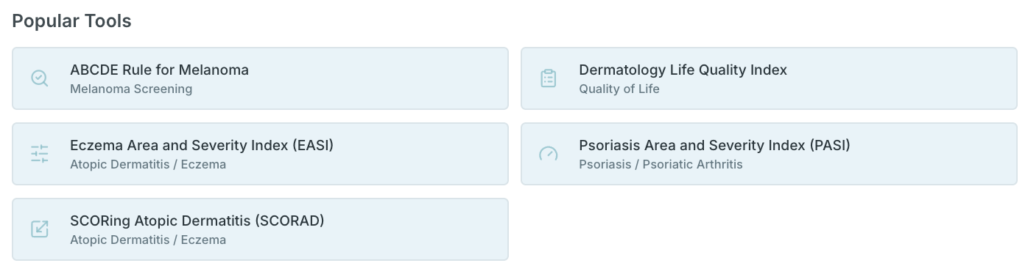
SkinScores
Scoring Tools for Dermatology
[SIDEBAR CONTENTS HERE WITH ORGANIZED LISTING OF ALL TOOLS IN COLLAPSED GROUPINGS (AS IN CURRENT VERSION)]
Welcome to SkinScores
[Information about the tool and our mission] [Information about how to navigate the site]
[Information about calculations being conducted locally and securely]

